Slide 1

RAG – Retrieval Augmented Generation
By

Slide 2
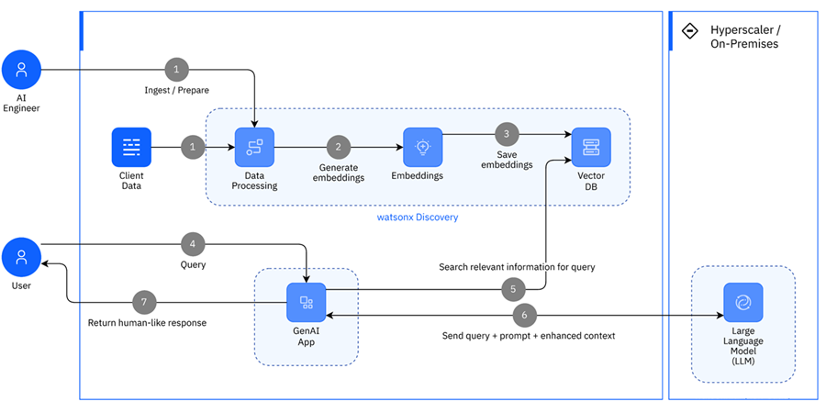
RAG – Retrieval Augmented Generation
Notes:
https://github.com/langchain-ai/rag-from-scratch/tree/main
https://www.youtube.com/watch?v=sVcwVQRHIc8
https://www.youtube.com/watch?v=8sSHg1034r0 – with out langchain

Slide 3
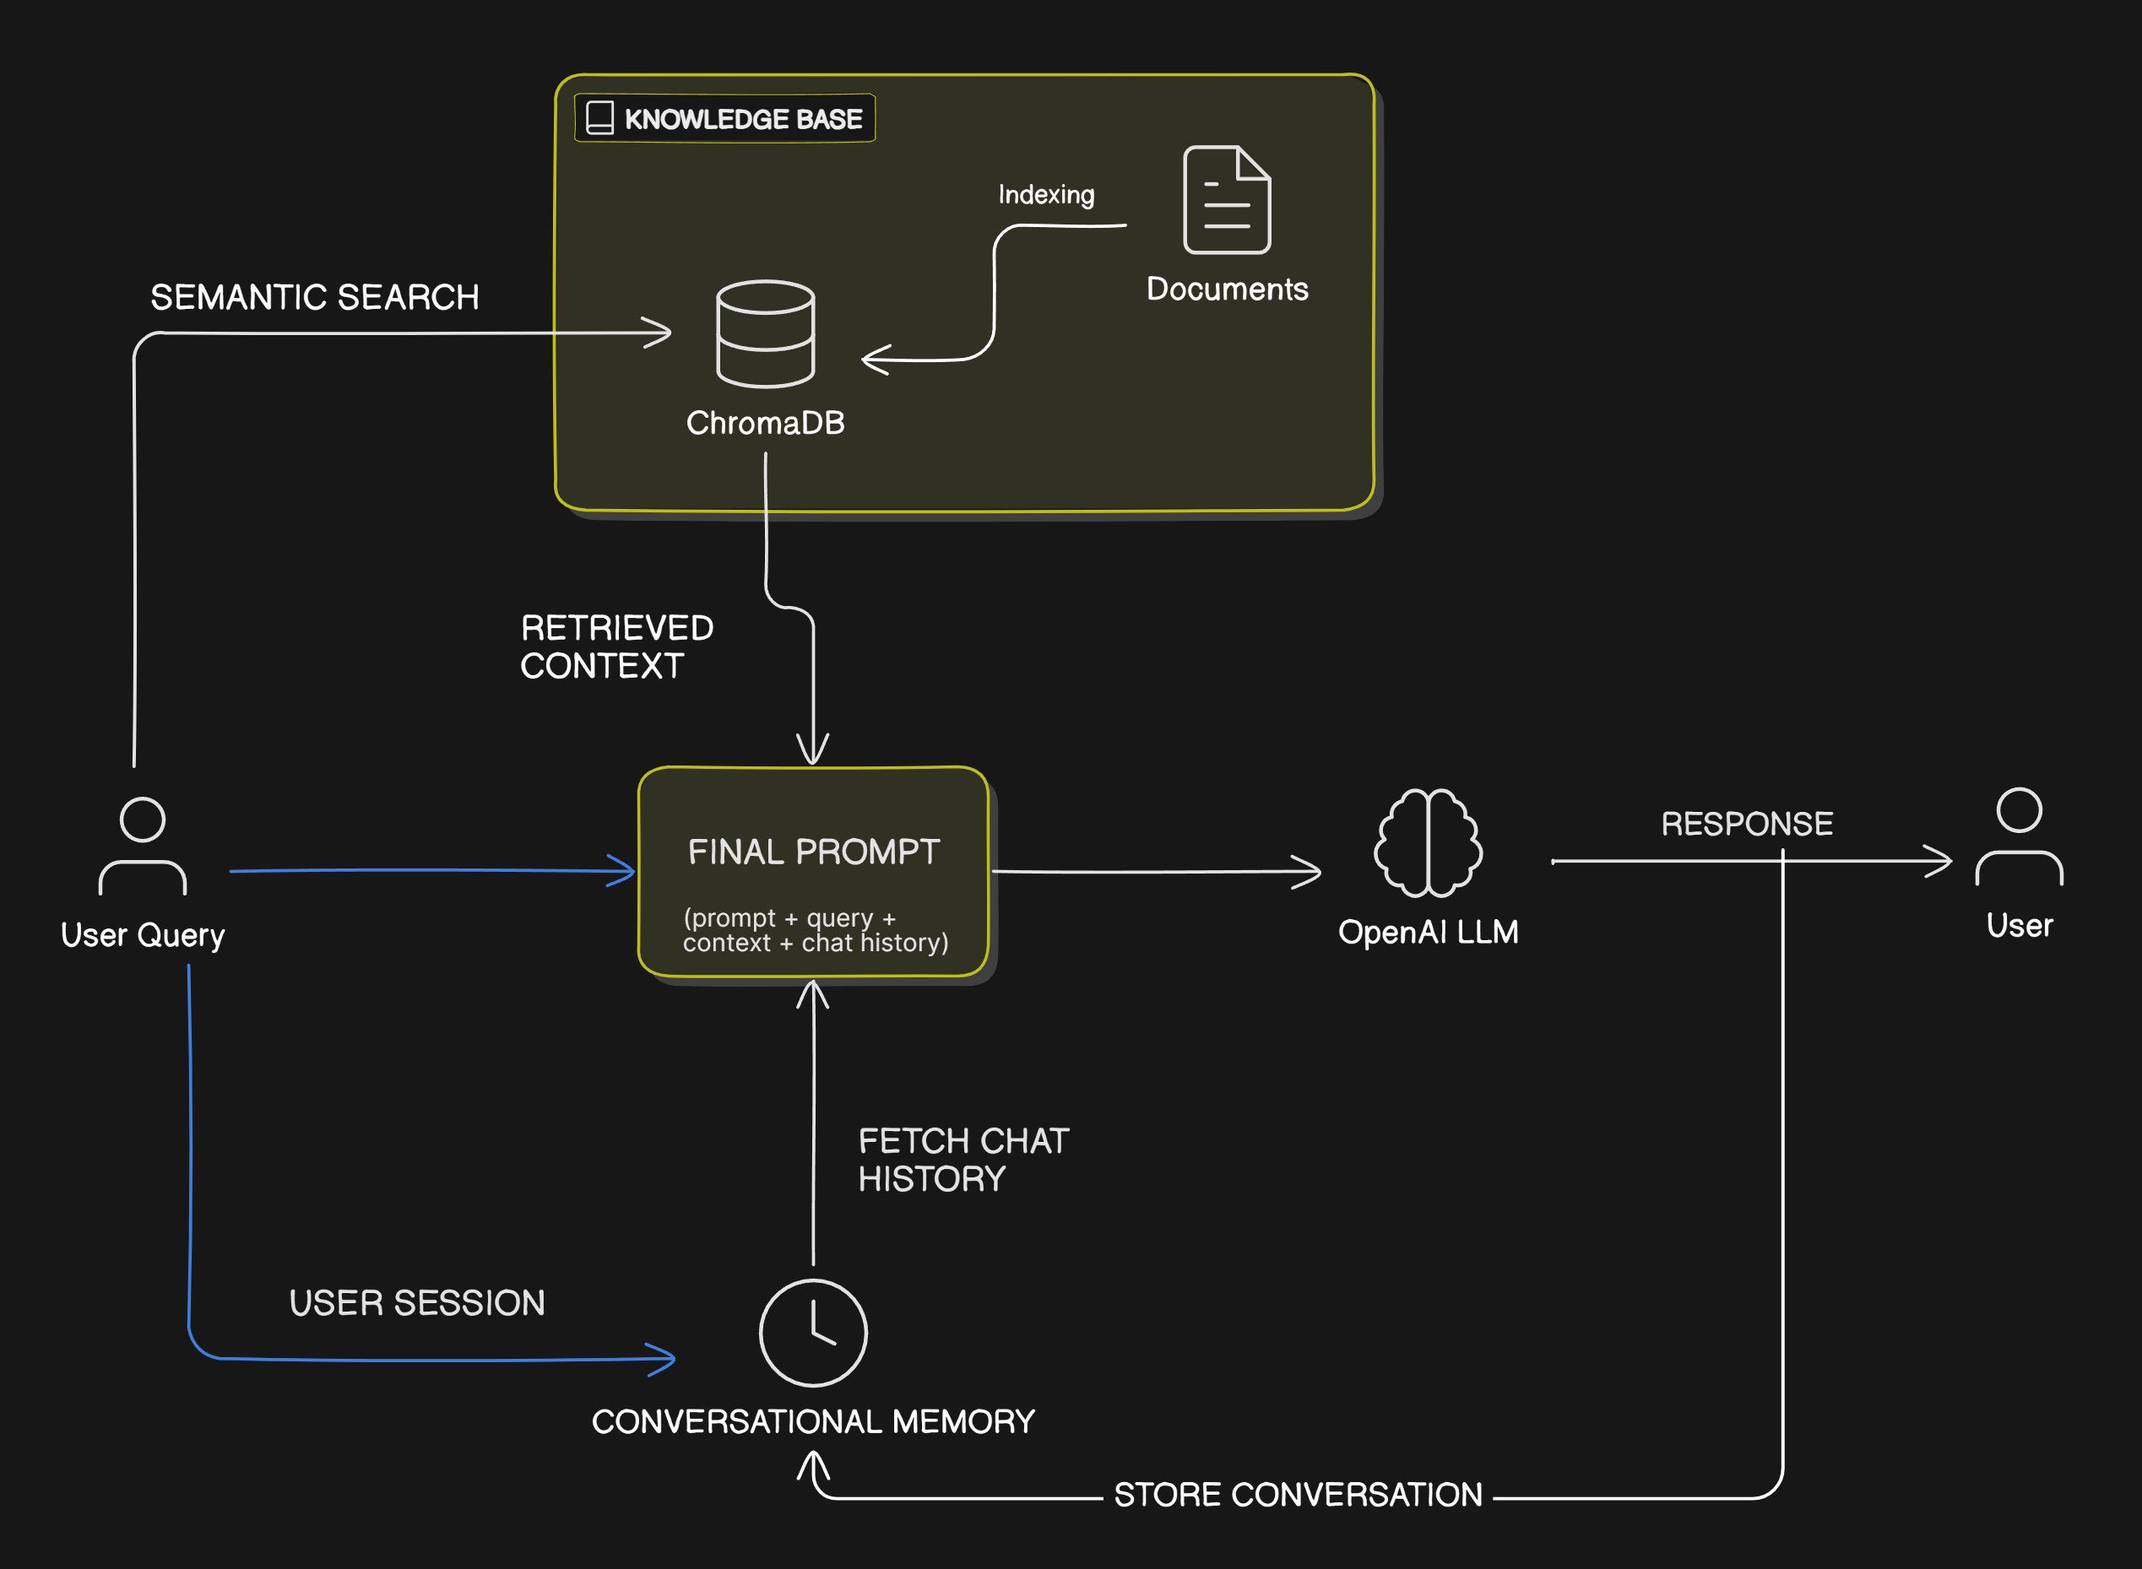
RAG – Retrieval Augmented Generation

Slide 4
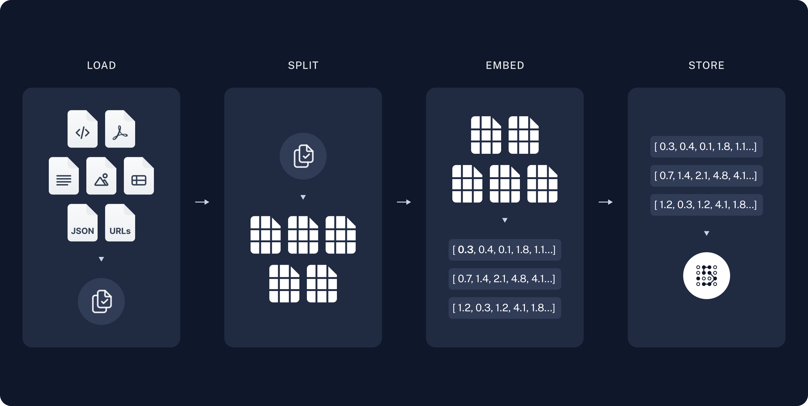
RAG – Retrieval Augmented Generation

Slide 5
RAG – Retrieval Augmented Generation
Retrieval augmented generation (RAG) is an architectural pattern that enables foundation models to produce factually correct outputs for specialized or proprietary topics that were not part of the model's training data.
The RAG (Retrieval-Augmented Generation) pattern consists of two main stages:
Build Time (Data Embedding)
Client data (manuals, documentation, tickets) is preprocessed through transformations (format conversion, restructuring) and enrichment (abbreviation expansion, metadata addition).
An embedding model converts the processed text into vector representations (chunks).
These embeddings are stored in a vector database (e.g., FAISS, Milvus, Chroma).
Runtime (User Query & Retrieval)
A user query is converted into an embedding and matched against stored vectors using semantic search to retrieve the most relevant data.
The retrieved information is then used to enhance an AI model’s response.
User Query: End-users enter a query in a GenAI-enabled application.
Search & Retrieval: The application searches the vector database for the top K relevant passages.
LLM Processing: Retrieved passages and a curated prompt are sent to the LLM.
Response Generation: The LLM generates a human-like response based on the query and context.
Output: The response is presented to the user.

Slide 6
Chunking Strategies in RAG
Fixed-Size Chunking
Aspect | Details
How it works | Splits text into chunks based on a fixed number of tokens/characters. Often includes overlap (e.g., 50 tokens).
Example | Text → split every 300 tokens with 50-token overlap. Chunk 1: tokens 1–300 Chunk 2: tokens 250–550 Chunk 3: tokens 500–800
Pros | Simple, fast, predictable.
Cons | Cuts meaning halfway; may split tables/code.
Best For | PDFs, long manuals, code docs, structured text.

Slide 7
Chunking Strategies in RAG
Semantic Chunking (Adaptive)
Aspect | Details
How it works | Uses embeddings to detect where the text changes topic. Embedding similarity drop → if adjacent sentences have low semantic similarity, create a new chunk. Percentile threshold (LangChain) → only split at strong semantic breaks. Clustering-based chunking → group semantically similar sentences the way LDA or K-Means would.
Example | Sentence similarity: Sim(S1,S2)=0.95 → same chunk Sim(S2,S3)=0.93 → same chunk Sim(S3,S4)=0.41 → new chunk
Pros | Meaning-preserving, very relevant chunks.
Cons | Slow, costly, may produce giant chunks if all sentences are similar.
Best For | Blogs, Q&A, knowledge bases, conversational docs.

Slide 8
Chunking Strategies in RAG
Structure-Aware Chunking
Aspect | Details
How it works | Use the document structure to split meaningfully.
Example | a) Heading-based chunking - Split at: H1, H2, H3 Sections / chapters b) Markdown / HTML-aware chunking - Split at: <p>, <ul>, <h2>, <code>, etc. c) PDF positional chunking - Split by: Layout Left/right columns Paragraphs Table detection d) Code-aware chunking - Split by: Classes Functions Docstrings
Pros | Very high contextual accuracy,Maintains document structure,Works best for technical docs
Cons | Requires document layout parsing
Best For | Best for: PDFs, code, manuals, books, legal docs

Slide 9
Chunking Strategies in RAG
Query-Aware Chunking (Dynamic RAG) Chunking
Aspect | Details
How it works | Chunking happens based on user query intent. Techniques: Re-rank chunk boundaries based on query similarity Dynamic window expansion around relevant sections
Example | For code, fetch the function + relevant calls For legal text, fetch the clause + definitions
Sentence-Level Embedding + Grouping
Aspect | Details
How it works | Each sentence has an embedding, then you merge topically similar adjacent sentences.
Example | These methods include: Agglomerative clustering DBSCAN on sentence embeddings Topic modeling (LDA-based)

Slide 10
Chunking Strategies in RAG
Graph-Based Chunking
Aspect | Details
How it works | Build a knowledge graph instead of linear chunks. Extract entities + relations Create graph nodes (chunks) Link them semantically Better retrieval than simple chunks.
Example | Nodes: {CPU}, {GPU}, {Tensor Core} Edges: “GPU → contains → Tensor Core” Query: “What is Tensor Core?” Chunks: traverse GPU → Tensor Core.

Slide 11
Recommended Best Practice
Best 2-Strategy Combo:
Semantic chunking + fixed-size hard limit, This avoids over-large chunks when semantic similarity is high.
Best for production:
Structure-aware + semantic within sections
Best for chat-like data:
Overlapping sliding windows
Best for enterprise knowledge bases:
GraphRAG (graph-based chunking)

Slide 12
Document Extraction Tools
Feature / Tool | PyMuPDF | Docling (NVIDIA) | Azure Document Intelligence
Type | Local parser | AI-powered layout + OCR | Cloud OCR + Document AI
Extraction | Raw text + coords | Structured MD/HTML/JSON | Structured JSON
Table extraction | Manual | ✔ Very strong | ✔ Very strong
OCR | ❌ No | ✔ Yes | ✔ Yes
Layout detection | ❌ Basic | ✔ Strong AI | ✔ Strong AI
Hierarchy reconstruction | ❌ No | ✔ Yes | ✔ Yes
Ideal for | Clean PDFs | RAG / Scientific PDFs | Forms, receipts, enterprise docs
Speed | ⚡ Fast | Medium | Medium
Cost | Free | Free | Paid (usage-based)
Customizable | High | Very high | Medium

Slide 13
Thank you

